Slide 1
Wireless
DEFINITION:
In networking terms, wireless refers to a method of transmitting data between devices without using physical cables. Instead, it uses radio waves, infrared, or microwave signals to send and receive data through the air.
wireless access point (AP) or wireless router acts as the central hub that broadcasts signals and connects devices to a wired network or the internet.
Communication occurs using protocols like IEEE 802.11 (Wi-Fi) or Bluetooth (IEEE 802.15).
AD-HOC: (No central device)
Ad-hoc wireless is a type of wireless network where devices (like laptops, phones, or IoT devices) communicate directly with each other without using a central access point (like a Wi-Fi router or wireless access point).
Each device acts as both a host and a router.
Data is passed peer-to-peer (P2P), and devices can relay traffic for others if they are out of direct range.
The network is created on the fly (hence "ad-hoc") and can reconfigure itself dynamically as devices join or leave.

Slide 2
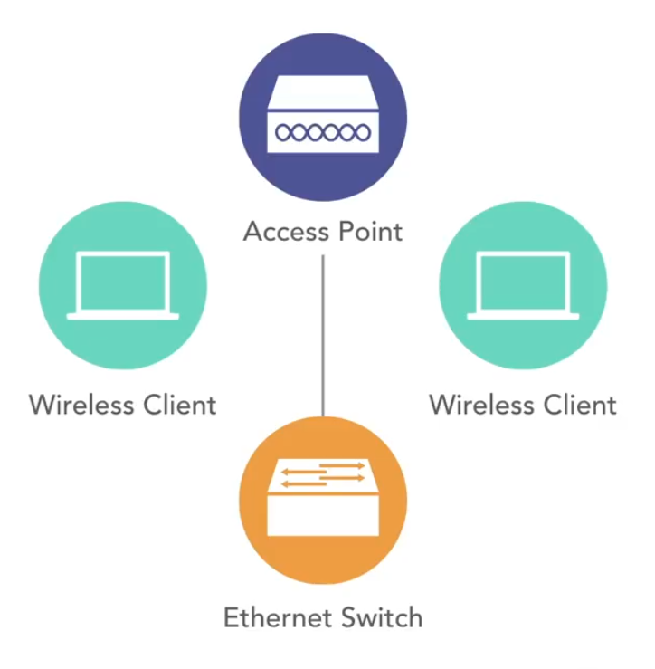
INFRASTRUCTURE WLAN
Ad-hoc wireless
• No need for network infrastructure
• Convenient for file transfers
• Typically uses Bluetooth or WIFI
• Wireless clients connect to
access points
• Access points-connect to wired infrastructure
• Scalable by adding access points
• Supports management and
monitoring features not available with ad hoc wireless networks

Slide 3
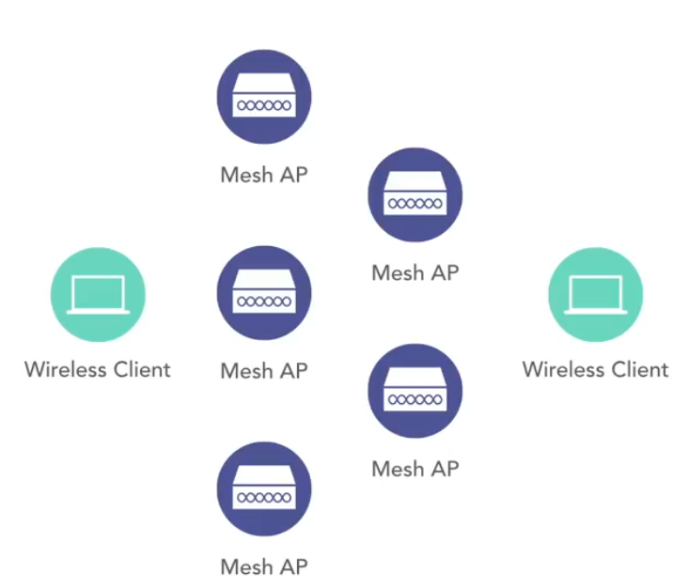
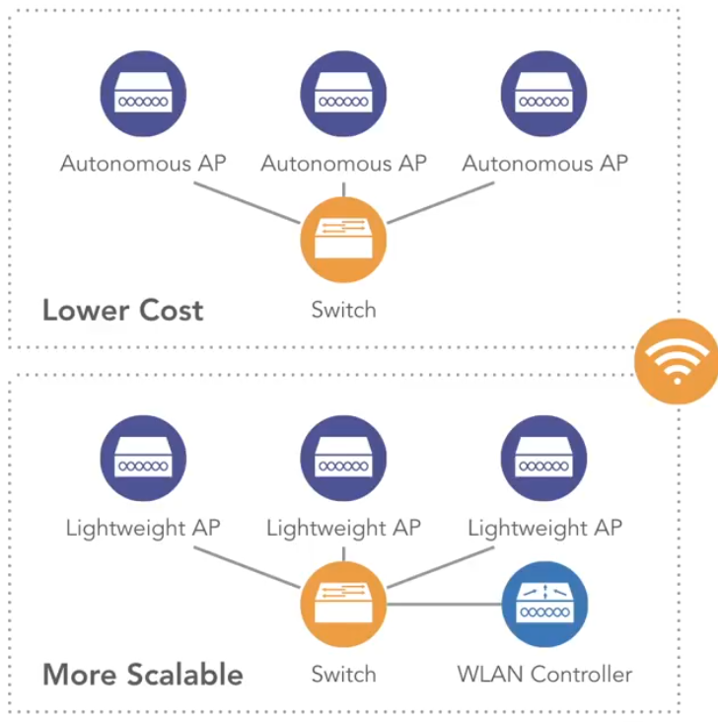
MESH WLAN
• Mesh access points need not be connected with a wired infrastructure
• Mesh access points receive and retransmit a wireless signal
• Allows for flexibility in access point placement
Autonomous vs.
Lightweight APs
• LWAPP: LightWeight
Access Point Protocol
• CAPWAP: Control and
Provisioning of Wireless
Access Points
Standalone AP, Fat AP

Slide 4
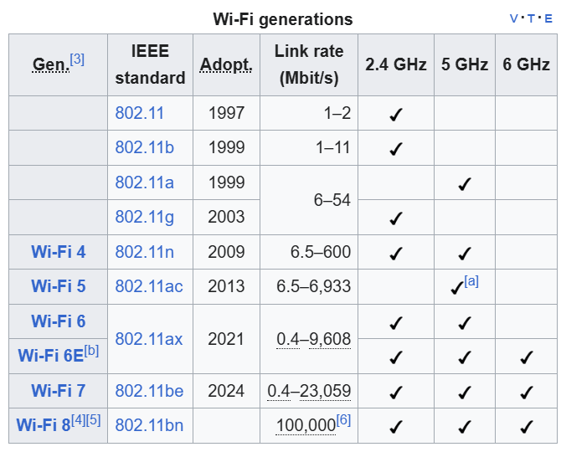
WIFI CHANNEL

Slide 5
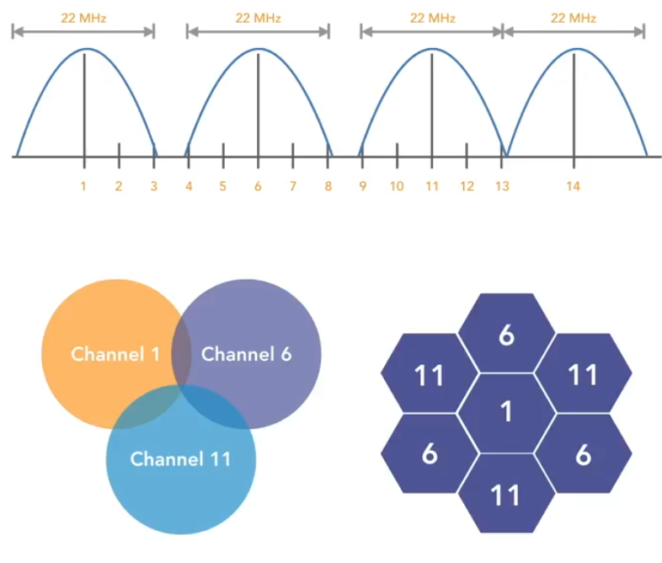
SELECTING WIFI CHANNEL 2.4 GHZ
2.4 GHz Channels
• 5 MHz between channels
• Exception: 12 MHz
between channels 13
and 14
• Channel 14 only allowed in
Japan for 802.11b
Range: Longest range (covers a bigger area)
Speed: Slower speeds compared to 5 GHz and 6 GHz
Penetration: Best at penetrating walls and obstacles
Congestion: Very crowded (used by Bluetooth, microwaves, baby monitors, etc.)
Best for: Browsing, IoT devices, older devices

Slide 6
SELECTING WIFI CHANNEL 5GHZ
Range: Medium range (shorter than 2.4 GHz)
Speed: Faster than 2.4 GHz
Penetration: Weaker at passing through walls
Congestion: Less crowded than 2.4 GHz
Best for: Streaming HD/4K video, online gaming, video conferencing
6 GHZ
Range: Shortest range (best in the same room)
Speed: Faster than 2.4 GHz
Penetration: Weaker at passing through walls
Congestion: Less crowded than 2.4 GHz
Best for: Streaming HD/4K video, online gaming, video conferencing
It supports wpa3 security.

Slide 7
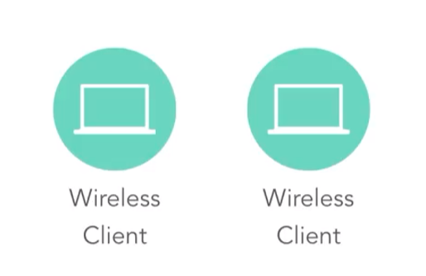
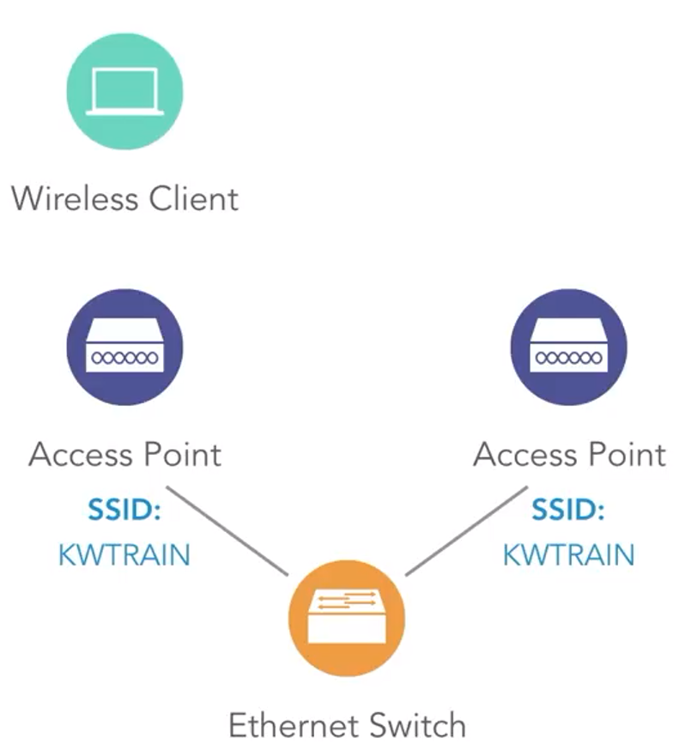
SERVICE SETS (IBSS, SSID)
Independent Basic Service Set (IBSS)
• Uses an ad hoc wireless design
• No need for a wired infrastructure • Useful for occasional file transfers
Service Set ID (SSID)
• The name of a wireless network
• Can be serviced by multiple access points
• Can be hidden to prevent
visibility to the casual user

Slide 8
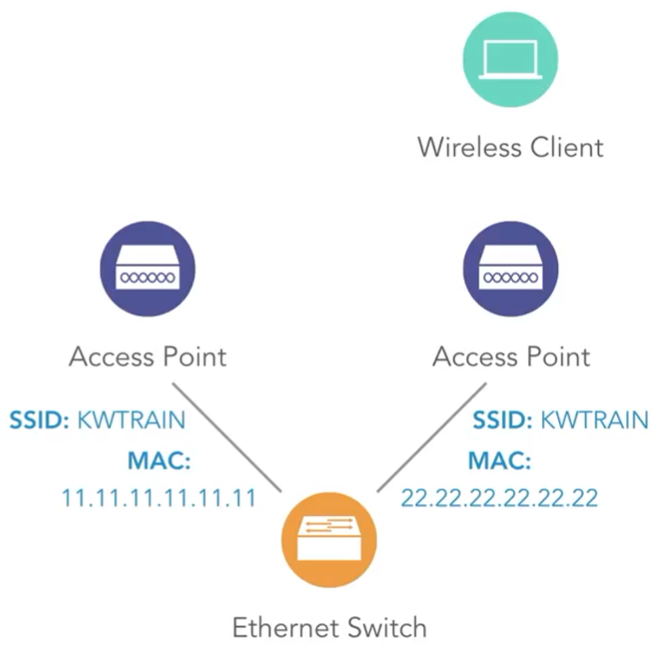
SERVICE SETS (BSSID)
Basic Service Set ID (BSSID)
• The MAC address on an
access point associated with
an SSID
• Allows clients to communicate with a specific access point
servicing an SSID
• Supports "roaming" between
access points
BSSID (Basic Service Set Identifier) is the unique identifier (MAC address) of a wireless access point (AP) or wireless interface that is part of a Wi-Fi network.
Here two different access points shares same ssid with different mac-address so the devices that are connected to ac1 can also be connected to the ac2.

Slide 9
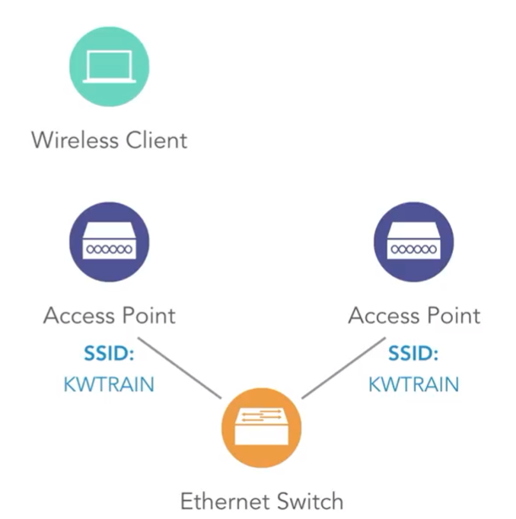
SERVICE SETS (ESSID)
Extended Service Set ID (ESSID)
• A collection of all basic
service sets
• The same as an SSID
SSID (Service Set Identifier): The network name (likeHome_WiFi)
BSSID (Basic Service Set Identifier): The MAC address of a single AP’s radio
ESSID (Extended Service Set Identifier): A group of multiple APs all connected to the same LAN and broadcasting the same SSID (ESSID = the SSID used by all APs in the ESS.)

Slide 10
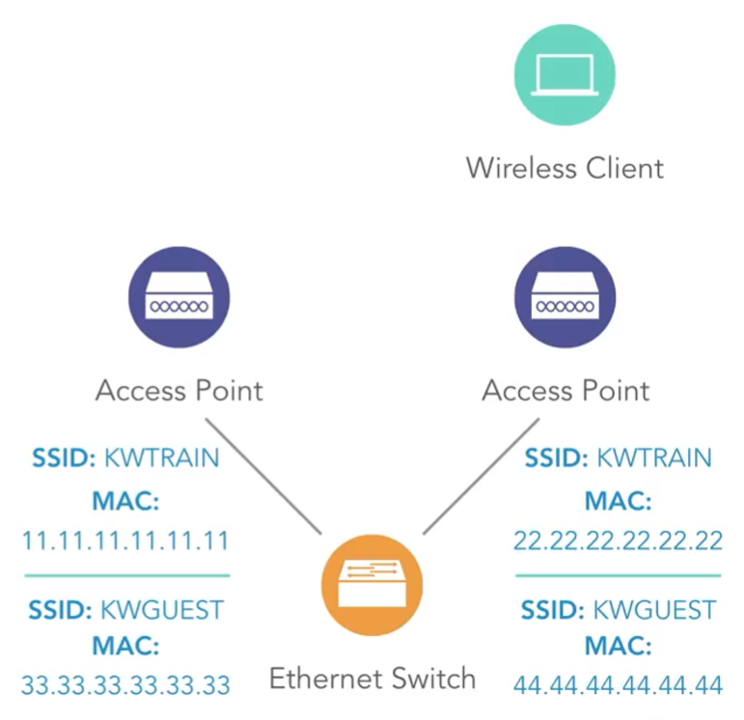
SERVICE SETS (MBSSID)
Multiple Basic Service
Set ID (MBSSID)
• A single access point can
support multiple SSIDs
• Each SSID on an access
point has a unique MAC
address
Why MBSSID is useful?
• Network segmentation: You can create different Wi-Fi networks (e.g., one for employees, one for guests) using the same AP.
• Different security policies: Each SSID can have its own authentication and encryption (e.g., WPA2-Enterprise for staff, WPA2-PSK for guests).
• Efficient resource use: Instead of deploying separate APs for each SSID, MBSSID lets one AP handle multiple virtual WLANs.

Slide 11
WIFI RADIO TECHNOLOGIES (DSSS)
What is DSSS?
Direct-Sequence Spread Spectrum is a way of sending a wireless signal by taking the original data and mixing it with a unique, high-speed code. This process "spreads" the signal over a much wider frequency band, making it look like random background noise to anyone who doesn't have the special code.
Why DSSS is important? • Protects against interference: Because the signal is spread out over a wide range, it is very hard for other devices or radio signals to interfere with it. A DSSS receiver can easily find and focus on the correct signal while ignoring other noise.
• Improves security: The signal is effectively hidden by the special chipping code used to spread it. Without this specific code, the signal looks like harmless static, making it difficult for unauthorized parties to intercept or understand the transmitted data

Slide 12
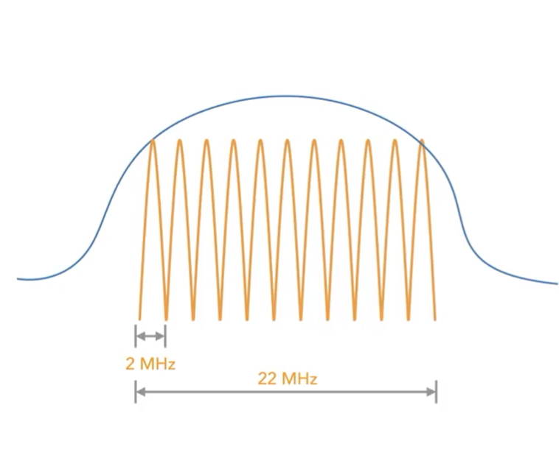
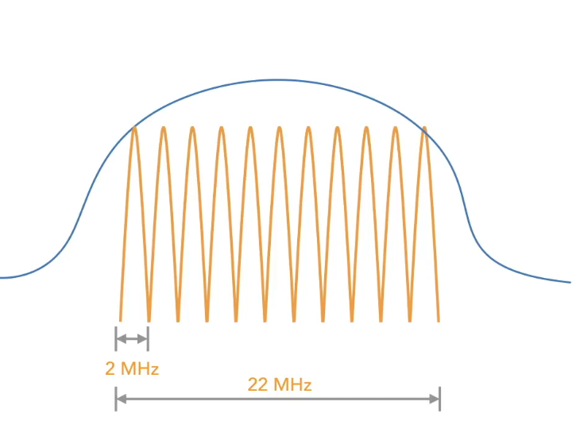
WIFI RADIO TECHNOLOGIES (DSSS)
• A single bit can be sent
using a 2 MHz frequency range
• Using Barker 1 1 coding,
1 bit is transmitted
along with 10 extra bits
(called "chips"), which
provide protection from interference
• A symbol is the sequence of 11 bits being sent to encode a single bit
• Used in the older IEEE
802. I lb wireless standard

Slide 13
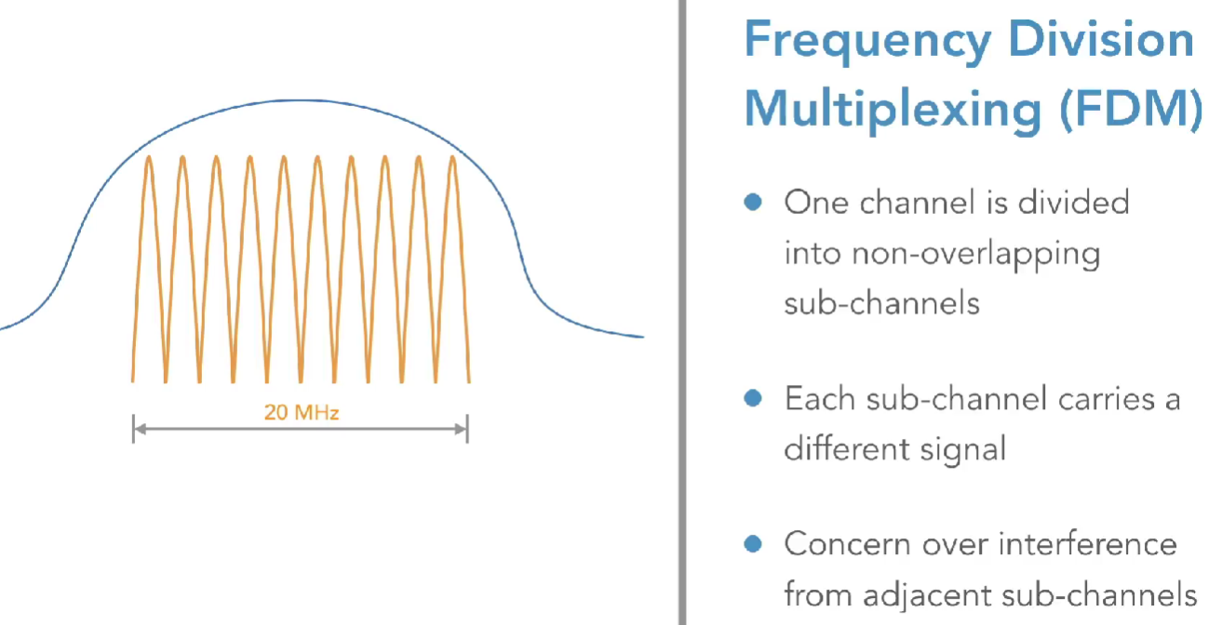
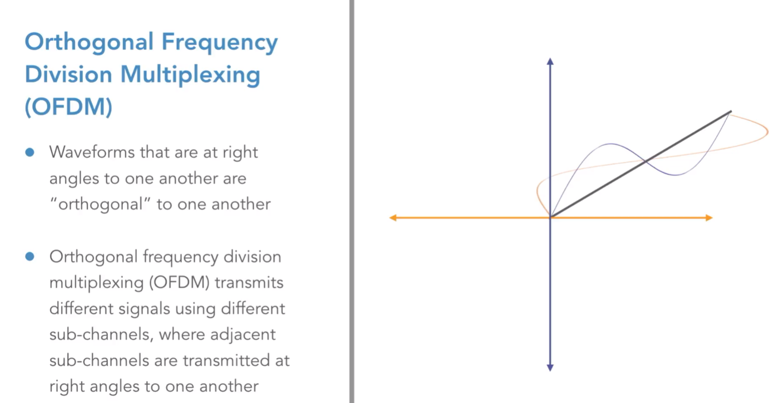
WIFI RADIO TECHNOLOGIES (FDM, OFDM)

Slide 14
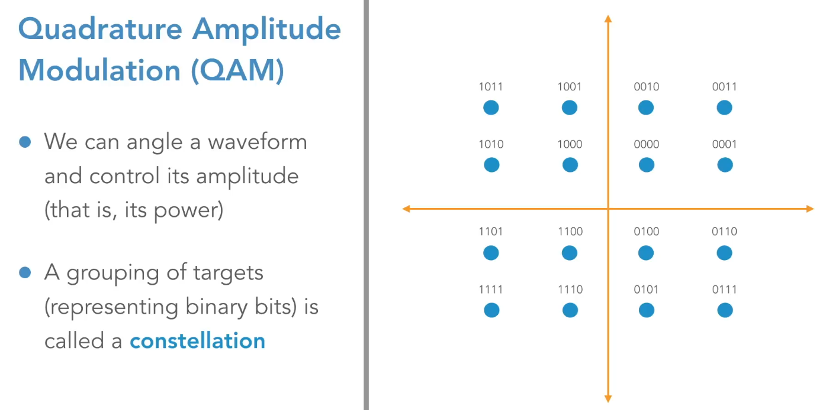
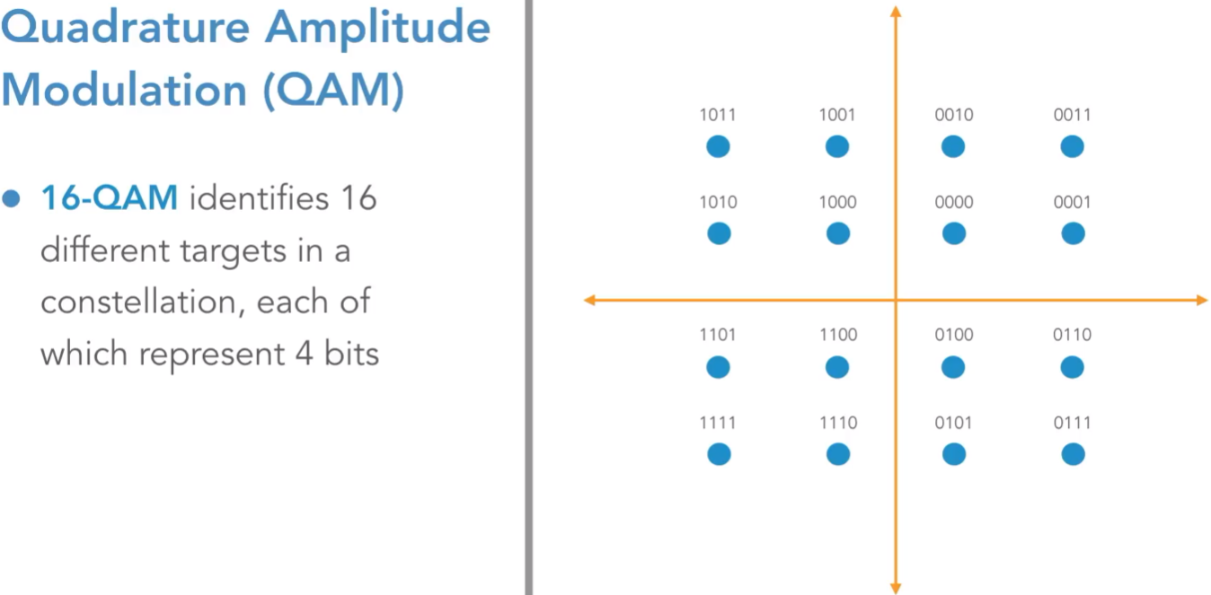
WIFI RADIO TECHNOLOGIES (QAM)
16, 64, 256

Slide 15
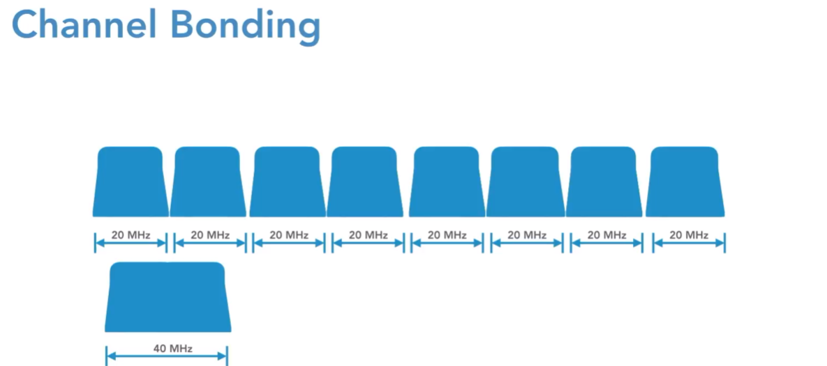
WIFI RADIO TECHNOLOGIES (Channel Bonding)
Channel bonding in wireless is the technique of combining two or more adjacent channels into a single, wider channel to achieve higher data rates.

Slide 16
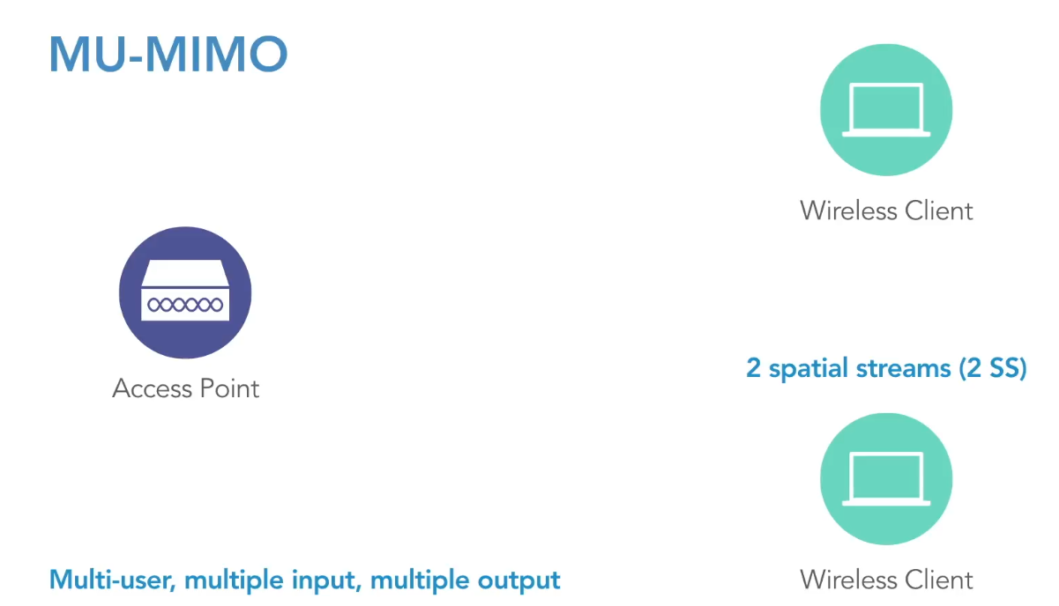
WIFI RADIO TECHNOLOGIES (MU-MIMO)
MU-MIMO – Multi User Multiple Input Multiple Output
In SU-MIMO (Single User MIMO), the AP talks to only one device at a time but uses multiple antennas to send multiple data streams to that one device.
MU-MIMO is a wireless communication technology used mainly in modern Wi-Fi networks (like Wi-Fi 5/6/7). In MU-MIMO, the AP uses its multiple antennas to send separate data streams to multiple different devices simultaneously on the same channel.

Slide 17
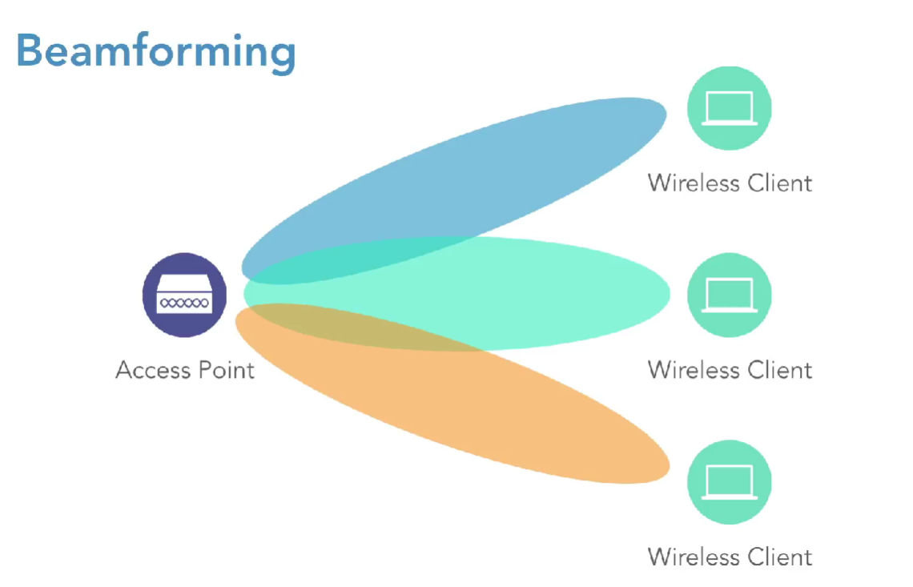

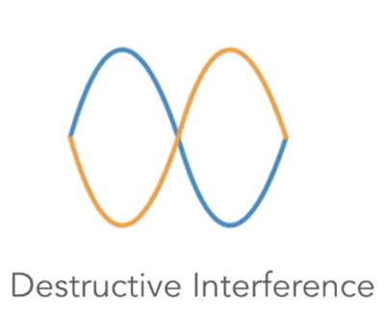

WIFI RADIO TECHNOLOGIES (Beam Forming)
Beamforming is a wireless technology used to focus signals toward a specific client instead of spreading them in all directions by creating constructive and destructive interference.
Constructive interference in wireless technology happens when two or more radio waves meet and combine in phase, meaning their peaks and troughs align (peak+peak and trough+trough). When this happens, their signal strengths add up, producing a stronger signal at the receiving point.
Destructive interference in wireless technology happens when two or more waves meet out of phase, meaning their peaks align with the troughs of the other waves (peak+trough). This causes them to partially or completely cancel each other out, resulting in a weaker or even zero signal.
Explains, how does noise cancellation work?

Slide 18
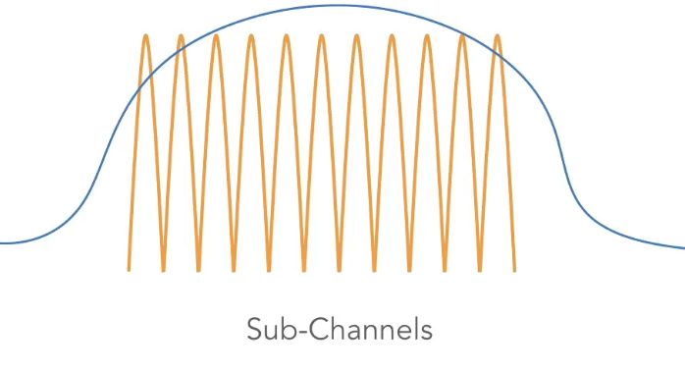
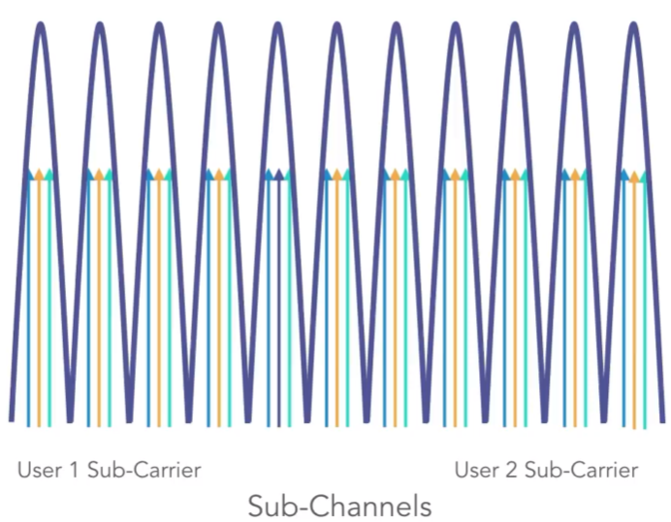

WIFI RADIO TECHNOLOGIES (OFDMA)
OFDMA – Orthogonal Frequency Division Multiple Access
Sub-channels are divided into sub-carriers
Each user is assigned a sub-carrier
We can also schedule the time.

Slide 19
BARKER-11
Spreading one bit into 11 chips:
Normally, sending 1 bit = 1 symbol.
With Barker-11, each 1 bit is encoded as 11 smaller bits (chips) using a fixed sequence like
+1, -1, +1, +1, -1, +1, +1, +1, -1, -1, -1.
Using more bandwidth (spreading):
Since each original bit becomes 11 chips sent at a higher chip rate, the signal occupies a much wider range of frequencies than the original data rate would require.
This is why it’s called spread spectrum.
Improved signal-to-noise ratio (processing gain):
Interference or noise might flip a few chips, but it very unlikely to flip all 11 chips that represent the same data bit.
The receiver collects all 11 chips and uses correlation to see which sequence was sent.
Because Barker-11 has very low correlation with any other random sequence, it’s easy to detect even in noisy conditions.
Error tolerance (auto-correcting behavior):
If some chips are corrupted, the receiver still sees the majority pattern and decides the bit correctly.
This gives the appearance of auto-correction — errors get rejected during correlation instead of becoming wrong bits.

Slide 20

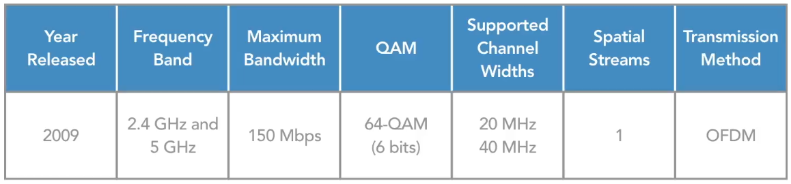

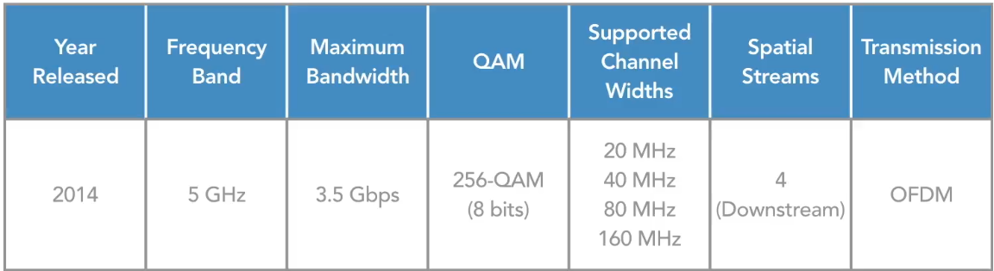
WIFI STANDARDS (802.11n-4, 802.11ac-5)
A modulation technique that encodes multiple bits per symbol by varying amplitude and phase (angle). Combination possible (channel bonding) Spatial streams – increase bandwidth

Slide 21
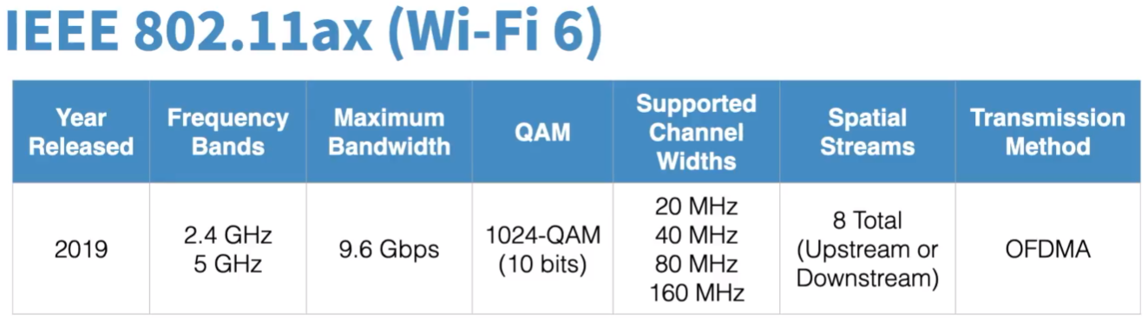
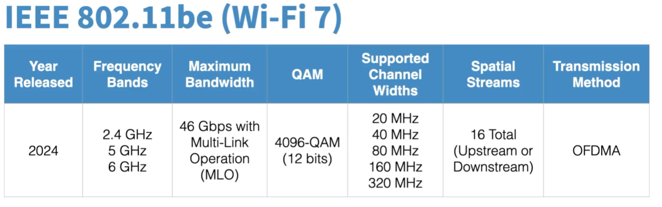
WIFI STANDARDS (802.11ax-6, 802.11be-7)
Uses Target Wake Time (TWT) to schedule when a client can send and receive, resulting in less latency and power savings
Uses BSS Coloring, which allows signals for one SSID on a specific channel to be distinguished from signals for a different SSID using the same channel by "coloring“
Wi-Fi 6E, an extension to Wi-Fi 6, released in 2021 with added support for the 6 GHz frequency band
It allows transmission of data on all 3 bands at the same time.

Slide 22
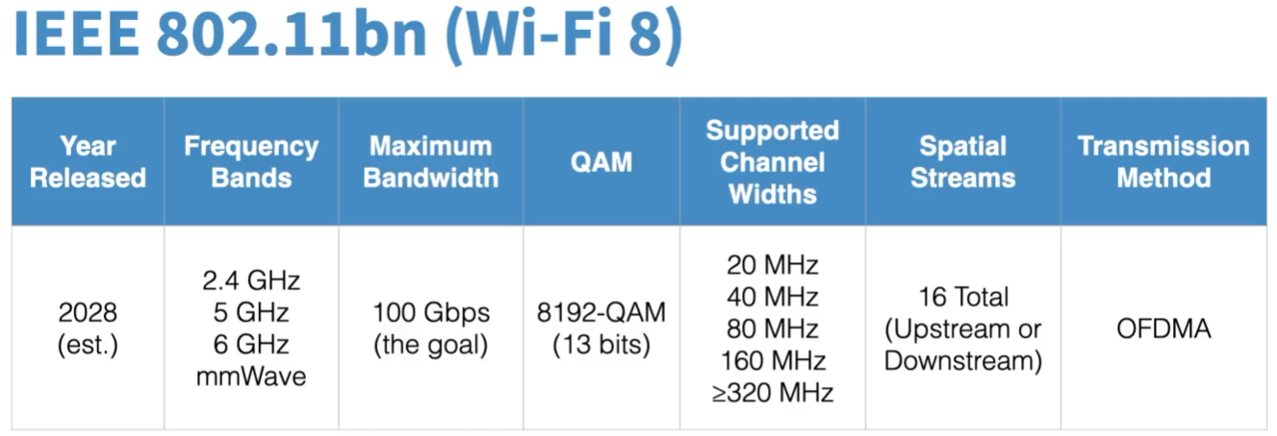
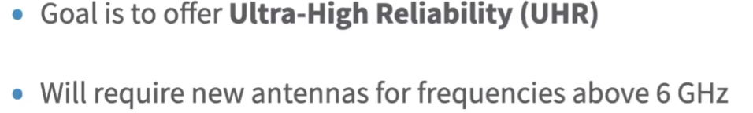
WIFI STANDARDS (802.11bn-8)

Slide 23
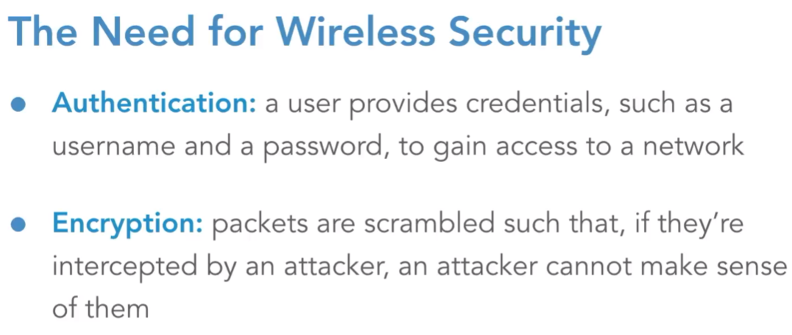
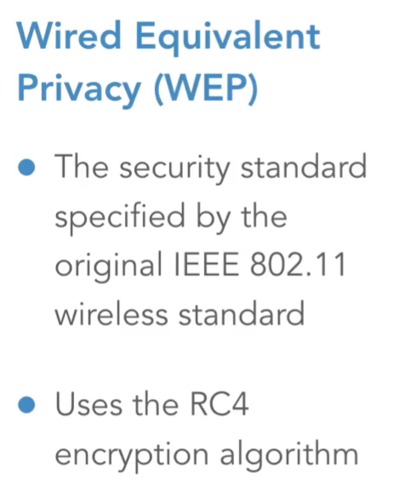

WIRELESS SECURITY Why? WEP
With the help WEP, we use something called initial vector or IV for short.
This IV is combined with shared secret key that we configure our access point and our wireless clients. IV – 20bits key – 40 or 140 bits

Slide 24
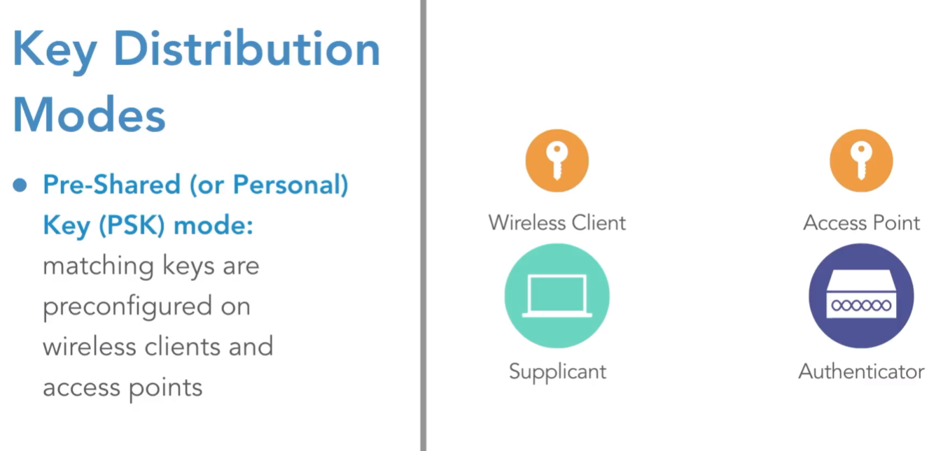
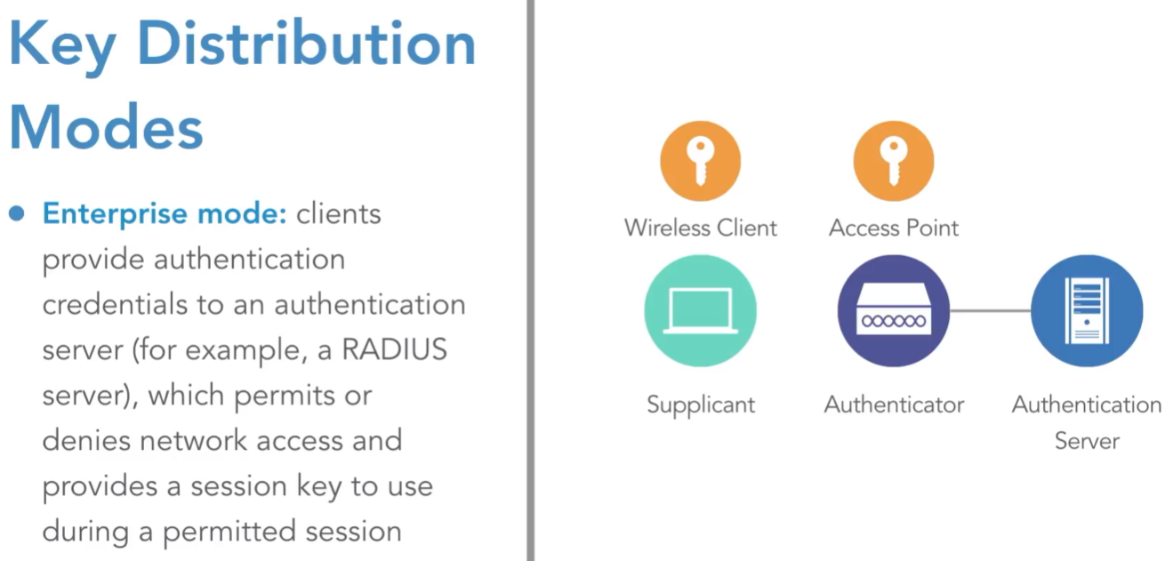
WIRELESS SECURITY Key Distribution Modes (PSK, AAA)

Slide 25
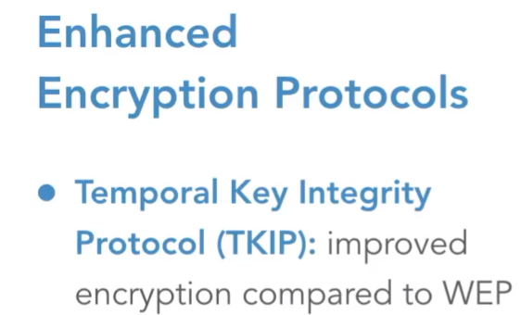
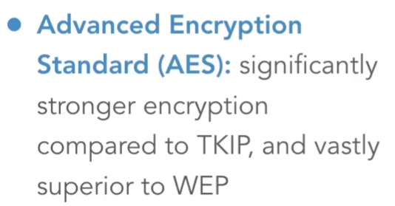
WIRELESS SECURITY TKIM relate to WEP
It uses Rc4 for underlying encryption algorithm, but it changed how the initialization vector was combined with the key. It uses 48 bit initialization vector as opposed to wep’s 24 bit initialization vector.

Slide 26
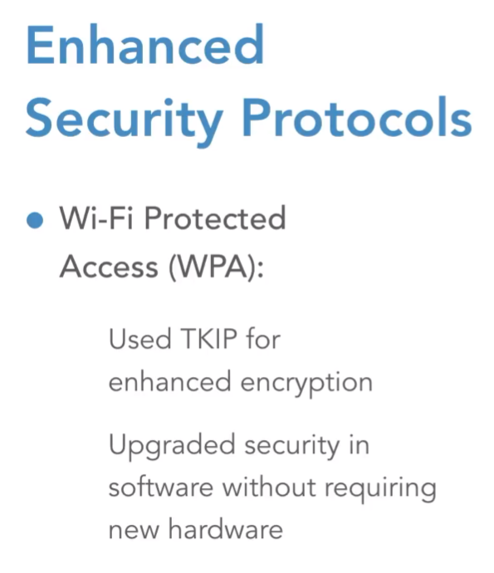
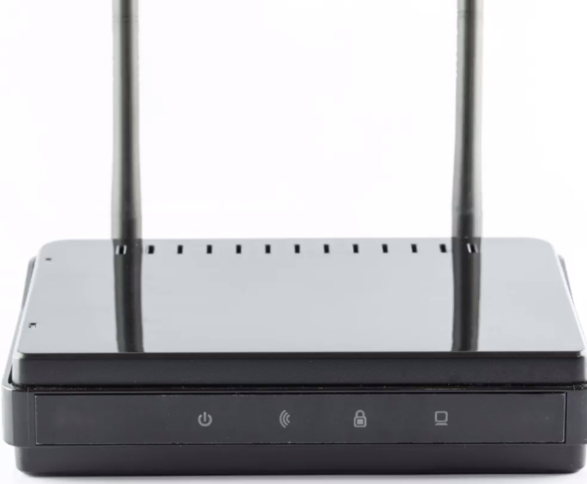
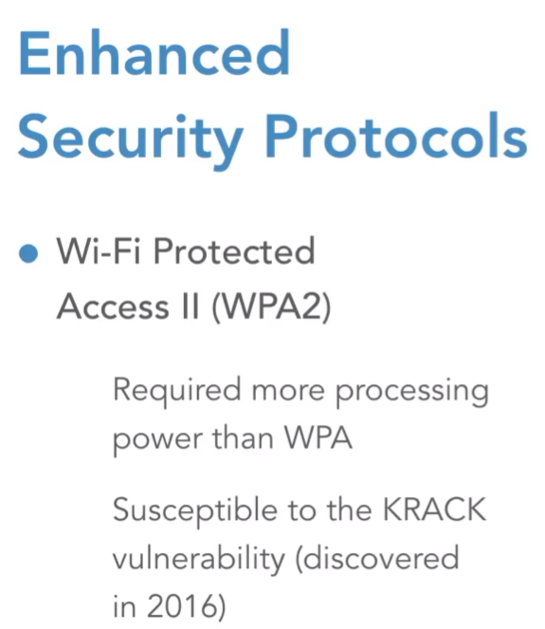
WIRELESS SECURITY WPA AND WPA2
We can also use TKIM for temporary encryption algorithm.
The aes-128bit algorithm is mostly used on wpa2.

Slide 27
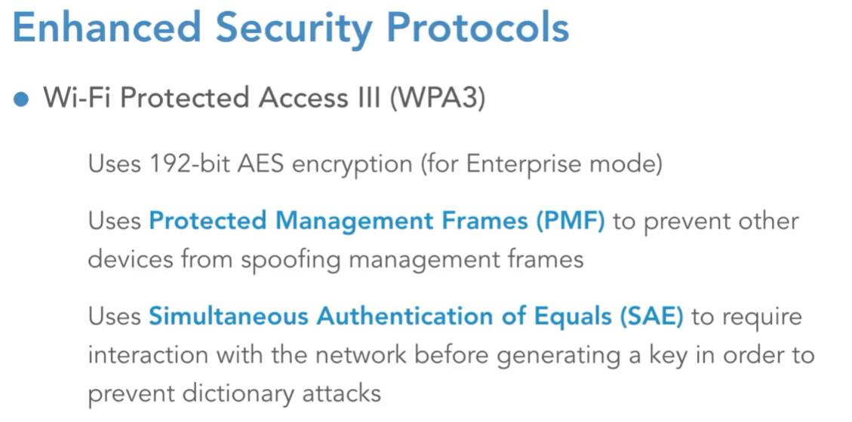
WIRELESS SECURITY TKIM relate to WEP
WPA3 doesn’t use WPS anymore (too weak). It uses DPP (Easy Connect) instead, which relies on QR codes, NFC, or public-key crypto to securely provision devices — eliminating the brute-force flaw of WPS.

Slide 28
WIRELESS SECURITY WPA3 vs WPA2
1. Stronger Authentication – SAE instead of PSK
WPA2: Uses Pre-Shared Key (PSK) with a 4-way handshake.
Vulnerable to offline dictionary attacks: if someone captures the handshake, they can try millions of password guesses offline.
WPA3: Uses Simultaneous Authentication of Equals (SAE), also called the Dragonfly handshake.
Even if attackers capture the handshake, they can only try one password guess per live session, making brute force extremely difficult.
2. Individualized Data Encryption
WPA2-Personal: Everyone connected with the same SSID/PSK shares the same encryption key.
WPA3-Personal: Provides forward secrecy. Each client gets a unique session key, so one compromised device or session does not expose others.
3. Stronger Encryption Standards
WPA2: Allowed older ciphers like TKIP (not secure anymore).
WPA3: Requires AES-128-GCMP at minimum, and in WPA3-Enterprise, it supports AES-256-GCMP.
This removes weak legacy protocols and enforces modern, strong cryptography.

Slide 29
WIRELESS SECURITY WPA3 vs WPA2
4. Forward Secrecy
WPA2: if the network password is leaked later, old traffic could be decrypted.
WPA3: session keys are derived per-connection and never stored, so even if the password leaks later, old captured traffic remains secure.
5. Better Enterprise Mode
WPA3-Enterprise: Offers a 192-bit security suite for government/military-grade networks.
WPA2-Enterprise didn’t have this standardized higher baseline.
6. Improved Protection for Open Networks
WPA2-Open = no encryption at all. Anyone can sniff your traffic.
WPA3-Open = uses OWE (Opportunistic Wireless Encryption), so even on public Wi-Fi without a password, traffic is encrypted individually between client and AP.

Slide 30
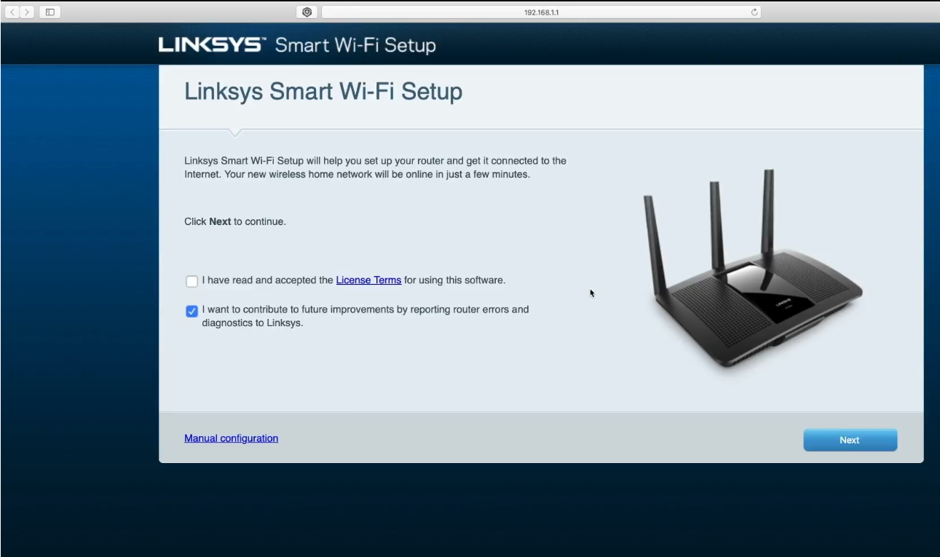
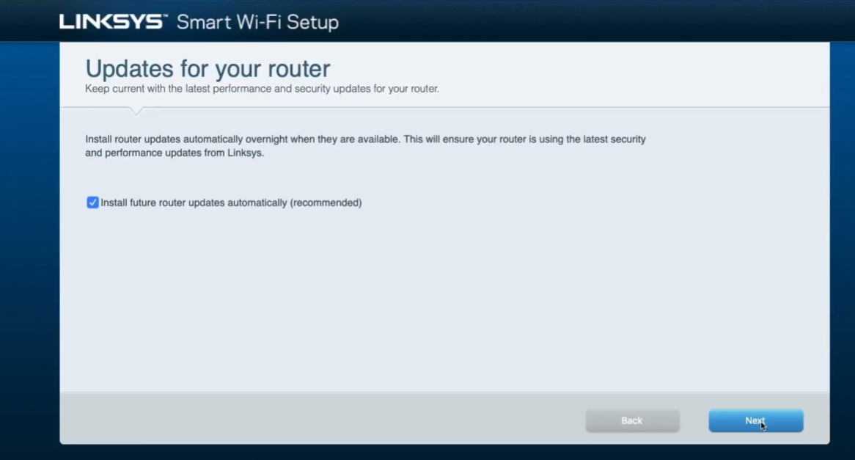
INSTALLING AN AUTONOMOUS AP
Mostly used default ip of the ap’s are 192.168.0.1 and 192.168.1.1

Slide 31
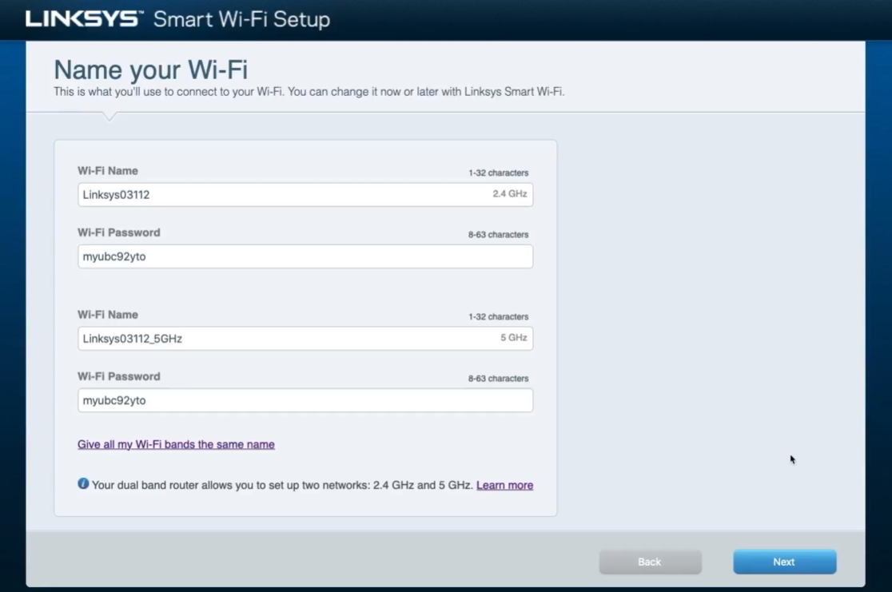
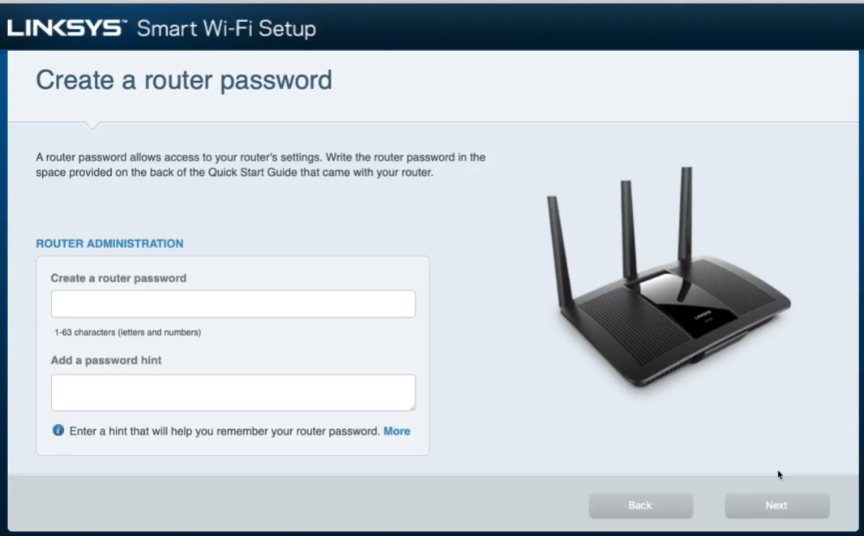
(Default name)

Slide 32
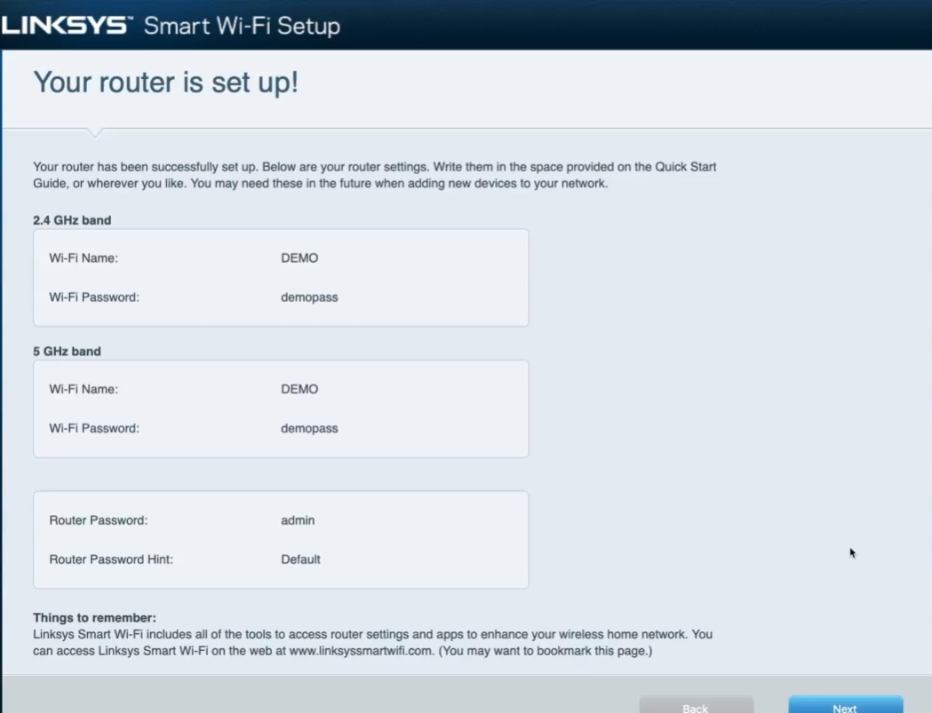
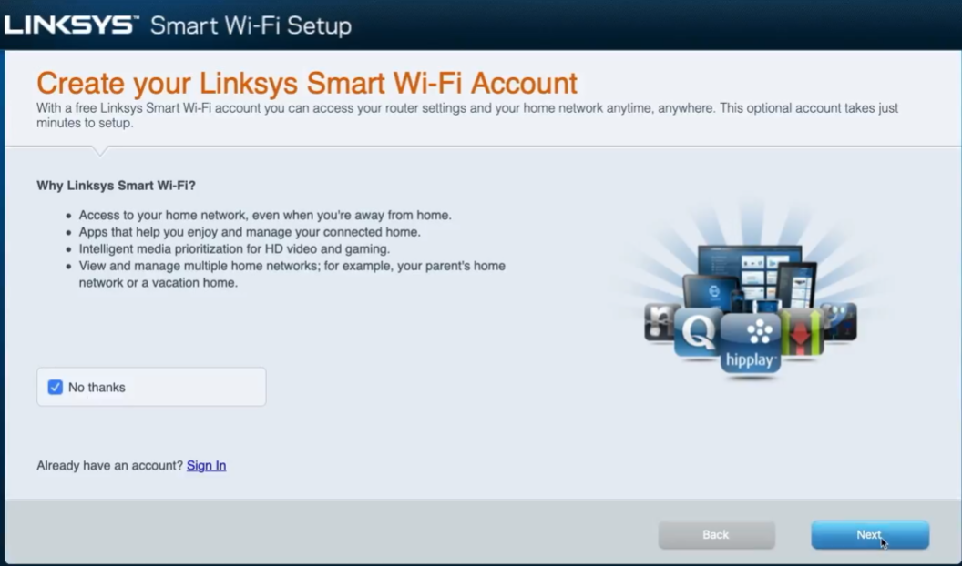

Slide 33
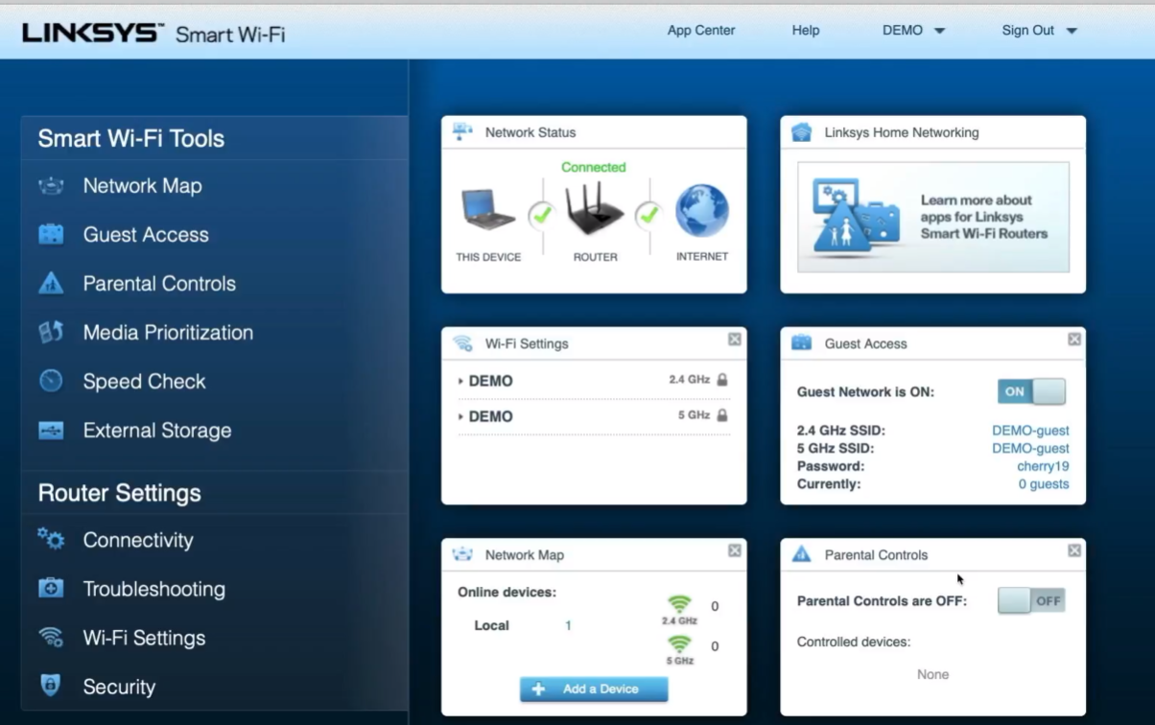

Slide 34
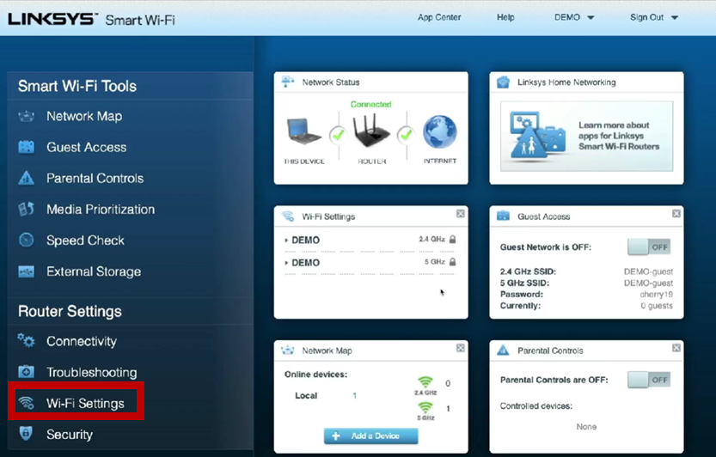
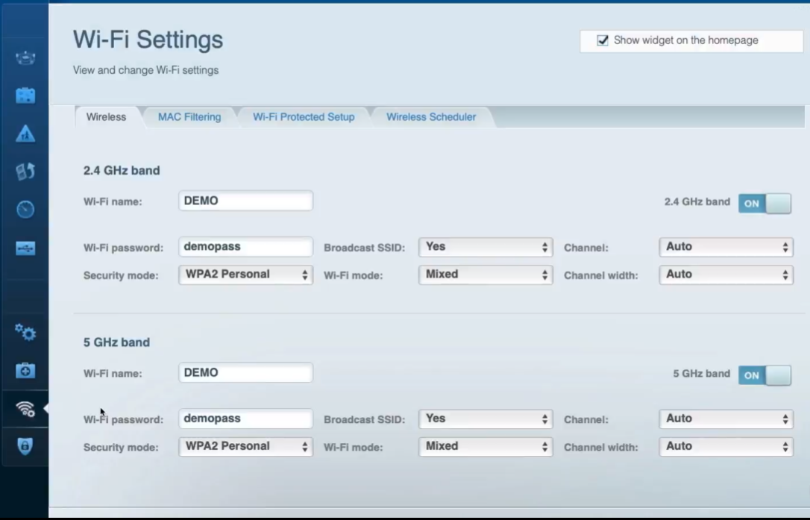
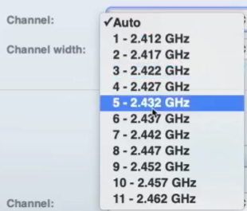



AUTONOMOUS AP CHANNEL SETTING

Slide 35
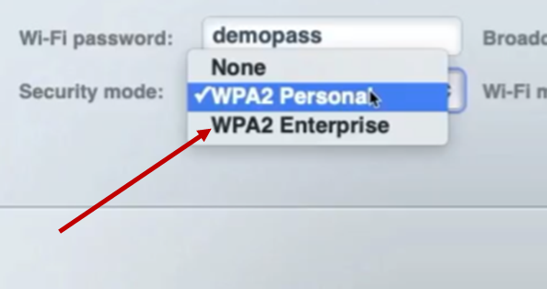
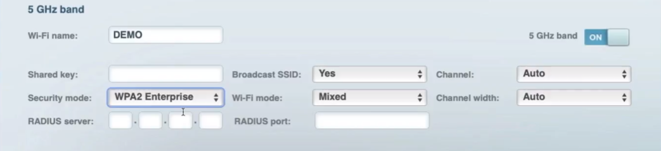
AUTONOMOUS AP SECURITY SETTING
Home – WPA2 personal
Enterprise – WPA2 Enterprise

Slide 36


UBIQUITY AP INSTALLATION
Unified Security Gateway
connect to ethernet switch
connect to internet
UniFi Could Kev Gen2 Plus Controller connect to POE switchport

Slide 37




UBIQUITY AP INSTALLATION
(1) - Enter the AP IP: 192.168.1.9
Default credential: ubnt ubnt

Slide 38



Successfully Configured

Slide 39



Log in using ubiquiti credential

Slide 40



It takes around 3 minutes.

Slide 41



Finally, launched successfully.

Slide 42




UBIQUITY AP
If you click mac-address or bssid of any device. You are going to get the box like right side.

Slide 43



UBIQUITY (ADDING NEW )AP
Channels:
After change (click on): Queue change – apply change

Slide 44



UBIQUITY SECURITY
Save it

Slide 45





Slide 46




Slide 47


Slide 48
Question
1. What is multi-hop communication?

Slide 49
REFERENCE
https://en.wikipedia.org/wiki/IEEE_802.11
https://www.linkedin.com/learning/wireless-networking-essential-training/

